Slide 1
Water sensitive urban design within the NBR
Dr Kirsty Carden
Future Water research institute
9th NRCS Annual Building Control Officers’ Convention 2019
22 November 2019

Slide 2
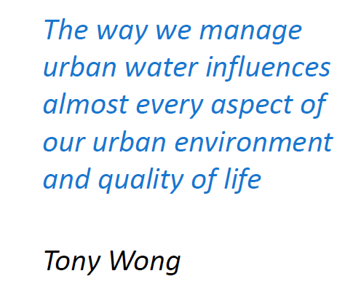

Slide 3
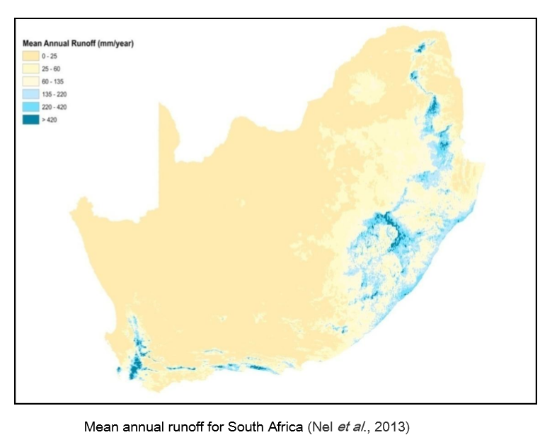
South African water resources
Uneven spatial distribution and seasonality of rainfall
Relatively low stream flow in rivers most of the time
Location of major urban and industrial developments remote from the country’s larger watercourses
70% of South Africa’s water resources are trans-boundary in nature
Notes:
In South Africa, we already have …..

Slide 4
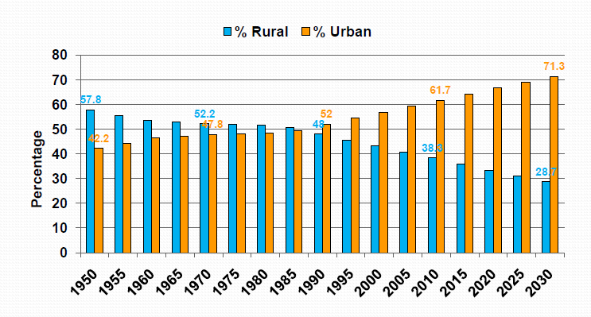
Urbanisation in SA: recognising risk
Source: Haldenwang, 2010
Notes:
Currently more than 60% of South Africa’s population live in urban centres that account for only 1.5% of the country’s surface area, and this figure is predicted to increase to over 70% by 2030. The result has been, and continues to be, an increasing demand for all resources, including water. Rapid urbanisation further complicates the situation as it “affects many resources and components of the environment in urban areas and beyond” .

Slide 5
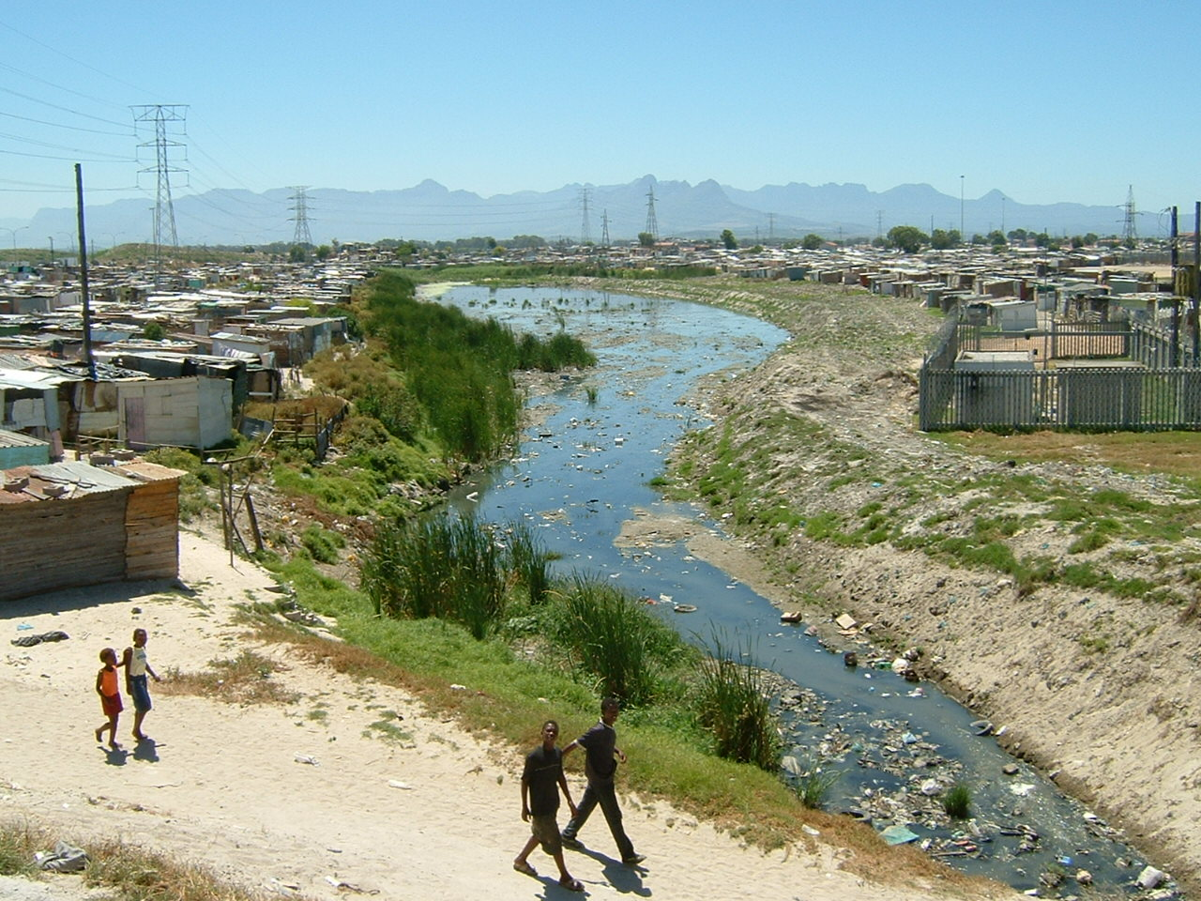
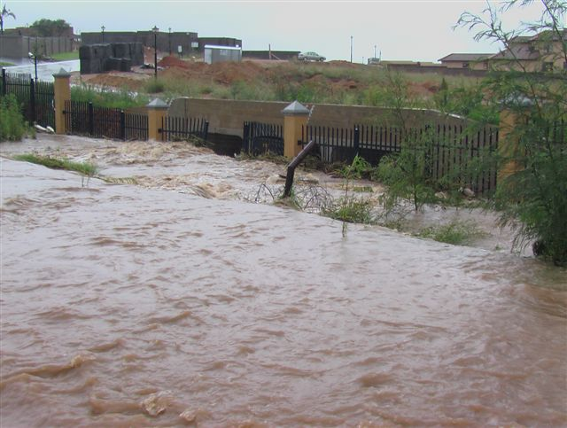
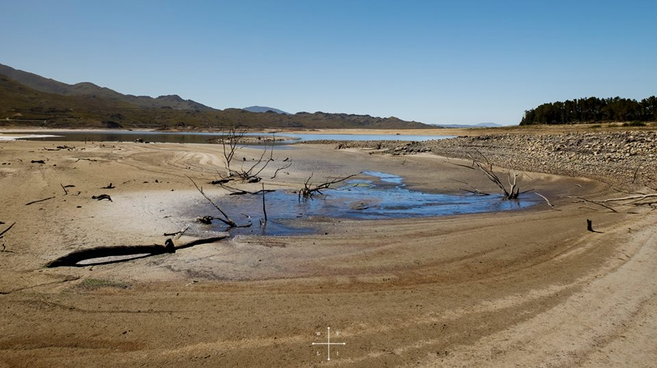
SA’s water crisis - “Too much, too little, too dirty”
Low rainfall / high evaporation
Urbanisation
Population growth
Services backlogs
Poor water quality
Leakage / wastage
Fragmented institutions
Quality of life
Poverty / inequality
…the availability of water of acceptable quality is predicted to be the single greatest and most urgent development constraint facing South Africa” (Scholes, 2001)
Notes:
So, South Africa’s crisis is fast approaching - it is generally thought of as too much, too little, too dirty. As the availability of easily-accessible water of good enough quality becomes more critical, there is increasing pressure to seek out alternative (and diverse) sources of water. And the future looks pretty bleak. The latest report (Parched Prospects) by the Institute for Security Studies states that SA is overexploiting its water resources at the national level. This means that national water withdrawals for municipal, industrial and agricultural sectors will increase over the next 20 years to exceed sustainable levels of supply. Proposed interventions for increasing supply and reducing demand are not enough to reconcile the gap between withdrawals and supply. More must be done to bring the South African water sector into balance and reconcile future national water withdrawals with future national supply.

Slide 6
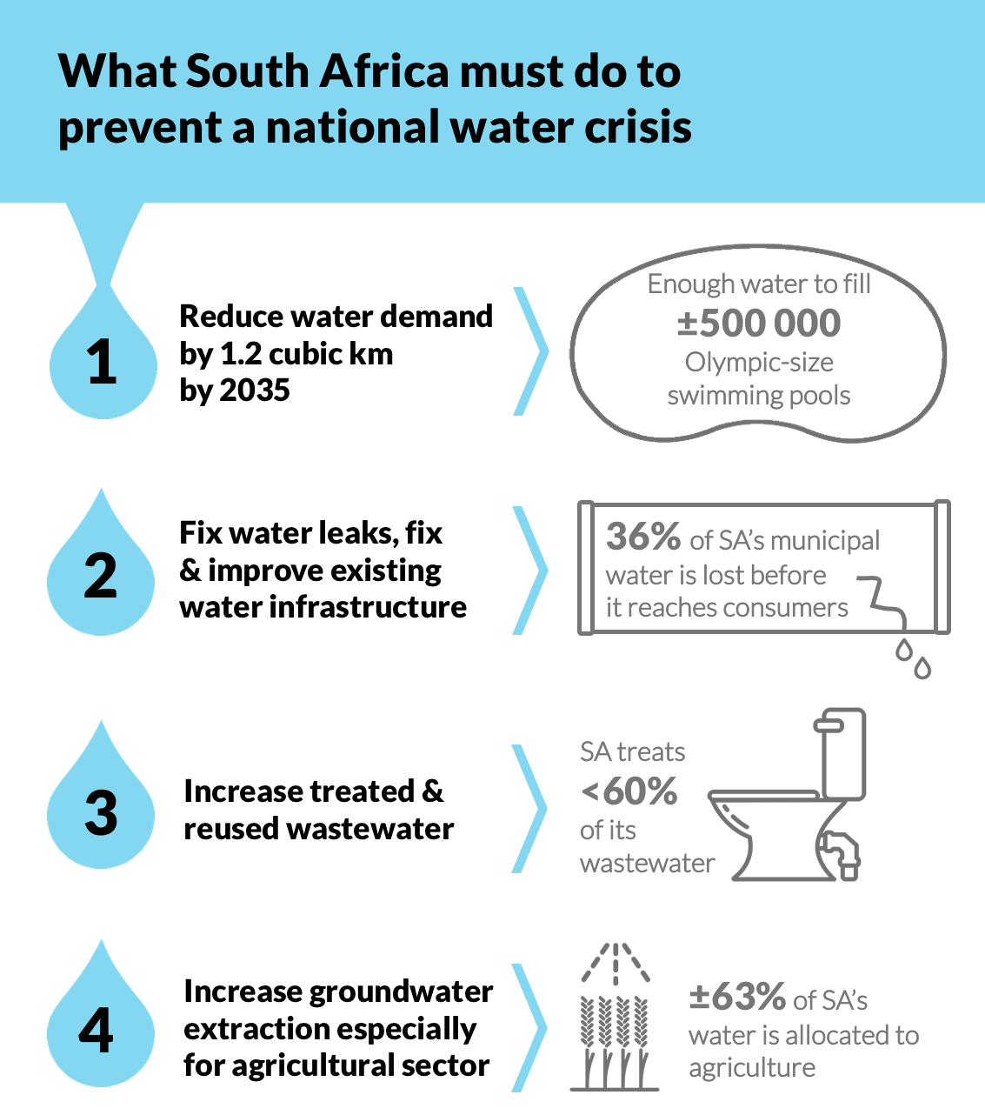

Slide 7
What can we learn from the CT crisis?
Improve commitment to building water sensitive cities with multifunctional infrastructure
Adapt much faster to water scarcity (‘drought as the new normal’) – build resilience
‘Conserve, Value and Enjoy Water’
Diversify water resources
Blue-green corridors
Water-energy-waste nexus
Change behaviour
Design principle – “keep water in the town / city”

Slide 8
Water Sensitive Urban Design (WSUD)
WSUD integrates water cycle management with the built environment through planning and urban design, providing multiple benefits and opportunities in order to overcome challenges with water management.
“WSUD is not a set of solutions or measures, but a process and philosophy to optimise both water management and urban design objectives” (CIRIA, 2013)
Notes:
WSUD is a multi-disciplined approach to urban water management aimed at ensuring that the urban water cycle is managed in a more sustainable manner which in turn will improve water security. It does this by focusing on the interaction between the urban built form and water resources management (Wong, 2006). By considering all aspects of the water cycle and their interaction with urban design, WSUD aims to be the medium through which sustainable urban water management (SUWM) can be achieved, where the sustainability objectives in this regard can be described as “satisfying water related needs … at the lowest cost to society whilst minimising environmental and social impacts”

Slide 9
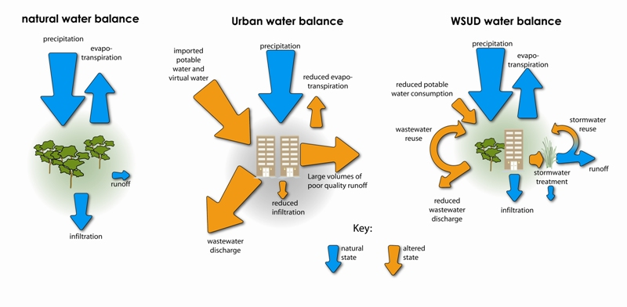
Influence of Water Sensitive Design on urban water cycle
Source: Hoban & Wong (2006)

Slide 10
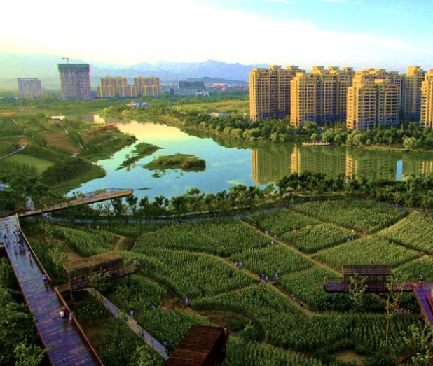
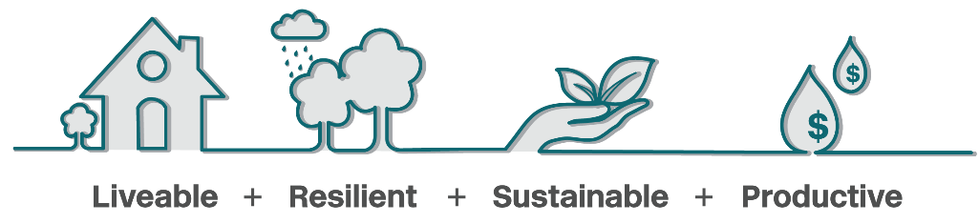
Water sensitive design and water sensitive cities
Sustainable water supply
Stormwater management
Wastewater minimisation
Design and planning
WSD is the process, WSC is the destination
Notes:
Important to note that WSD is not ONLY about stormwater and wetlands- and can be done at a range of scales, from household to city scale

Slide 11
What can WSUD help with?
Building flexibility & adaptability into water sources - including “Cities as Water Supply Catchments”
Building flexibility & adaptability into sanitation ensuring healthy cities
Blue-Green Infrastructure, “Cities providing ecosystem services”
Building social and institutional capital, “Cities supporting water-educated communities”
Sophisticated, equitable and Water Smart City
Better urban water management provides the core for multi-value multifunctional urban spaces that are fit to cope with future challenges
Notes:
The multi-objective approach offered by WSUD could offer a way forward for South Africa to meet the challenges of water resource constraints and service delivery by facilitating a change within cities from water wasteful to water sensitive environments. Dealing with risk!

Slide 12
Pillar 1
Cities as water supply catchments
Notes:
For example in Cape Town 3 times as much rain falls on the city as we use potable water

Slide 13
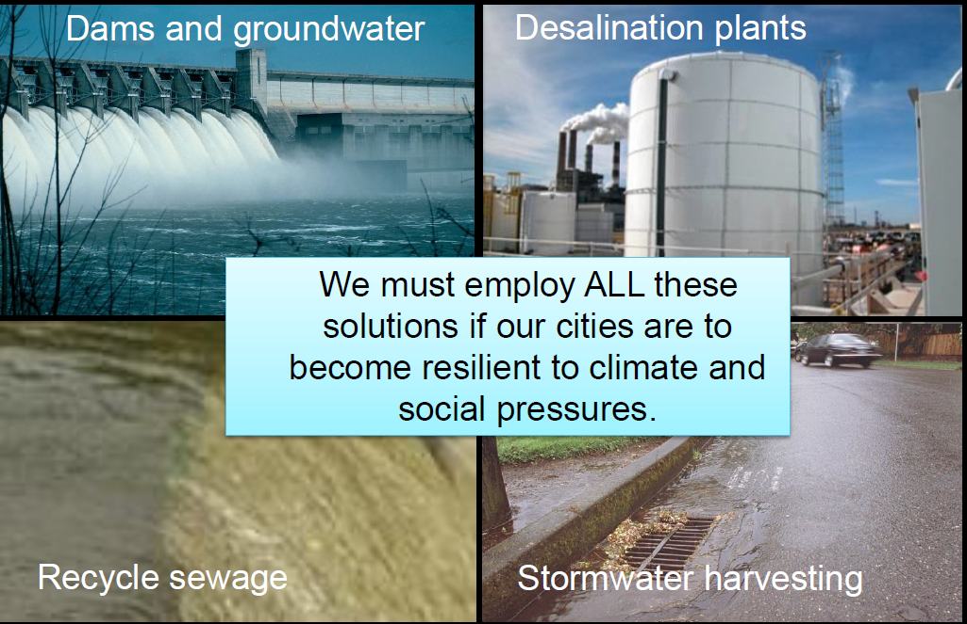
Water diversity – key to resilience
Notes:
Recycled sewage includes greywater use also

Slide 14
‘Closing the gap’ - many sources of water
Potable water (usually from surface water in RSA)
Water conservation / water demand management
Stormwater (from the local drainage system)
Rainwater (from roofs or similar)
Groundwater (including managed aquifer recharge)
Treated wastewater (from treatment works)
Light/dark greywater (from washbasins, showers, baths, kitchen sinks)
Acid mine drainage
Sea water
Simply a matter of relative costs and risk –the potential reuse of alternative water resources is as much a public health issue as it is a water conservation priority
Notes:
Important innovations around new sanitation, water treatment and wastewater treatment technologies, water efficiency measures, non-revenue water and alternatives sources of supply. Its simply a matter of the relative costs and risk – how do we do this efficiently and safely?

Slide 15
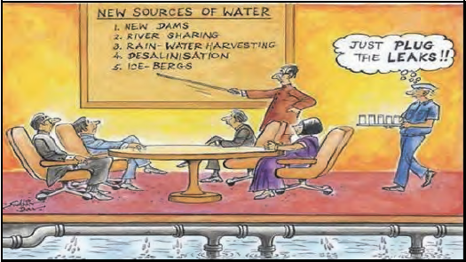
Water conservation / demand management
Pressure management
Leak detection
Tariffs
Water efficient devices
Water restrictions
Awareness campaigns
Notes:
But start with WC/WDM!

Slide 16
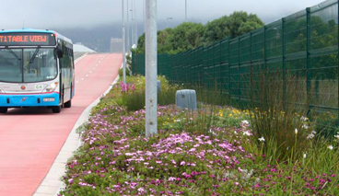
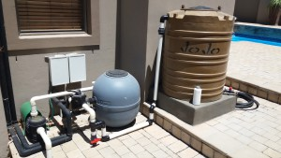
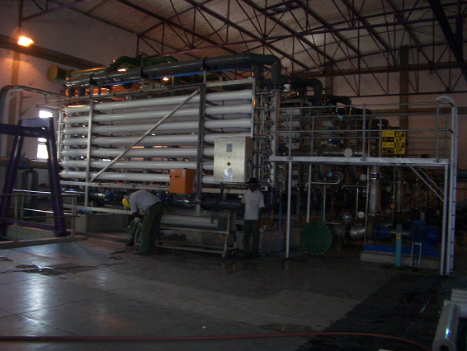
Treated wastewater use / reclamation
schools, sports clubs
golf courses, farms, irrigation
industry, commercial developments
direct potable reuse
greywater harvesting
Notes:
About 6% of all water used in the city is reused – from 13 WWTW

Slide 17

Diversifying household water sources
Precipitation
Evapo-transpiration
Rainwater Harvesting
Groundwater
Reduced volumes of runoff
Greywater reuse
Increased Infiltration
Reduced Municipal potable water demand
Reduced wastewater discharge
Stormwater Harvesting
Notes:
City promoted alternative water use throughout the drought – with relevant guidelines – only if done sensibly to avoid health risks, contamination of drinking water supply and environmental damage

Slide 18
Registration and licencing of alternative water use

Slide 19
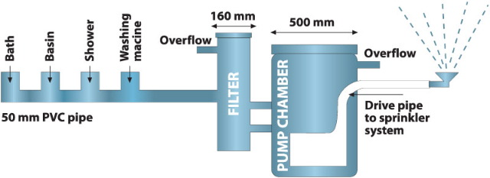
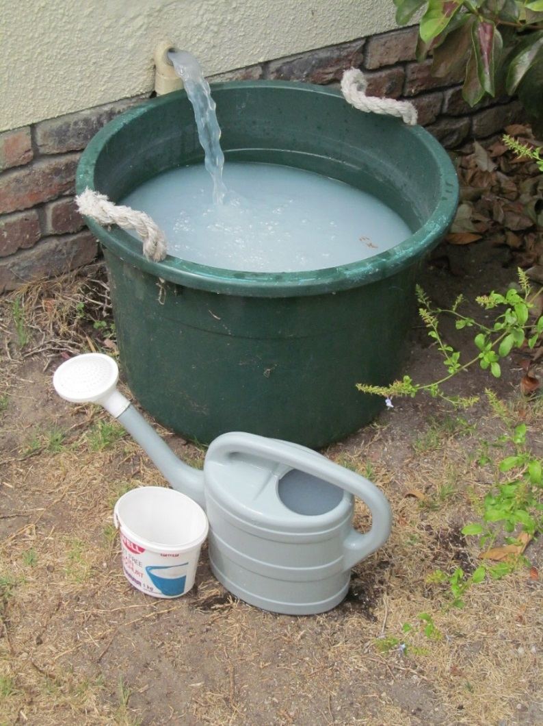
Greywater harvesting in serviced areas
Notes:
In South Africa, the use of greywater by individuals and companies has mainly been restricted to areas where alternative water sources are sought – often (but not always) during times of drought. This is partly owing to the fact that there remains little in the way of published local guidance as to how greywater systems should be designed, operated and maintained as part of an integrated water supply system. This project was thus aimed at providing the necessary guidance to support the wider adoption of domestic greywater management and use in South Africa. Very often simple, home-based systems are installed in response to drought conditions and water restrictions, but little is known about the potential risks associated with these sorts of practices – and the impacts of larger-scale implementation of greywater harvesting.

Slide 20
Greywater guidelines - CoCT
Municipal supply to be fitted with RPZ valve
Municipal supply to cistern to be disconnected
Collection and treatment in approved storage tanks
Underground tank to be at least 1m from boundary
Screen-filtered greywater for drip / subsurface irrigation
Collection, disinfection and distribution in second part of tank
Filtered and disinfected greywater for toilet flushing
Storage tank overflow to sewer, etc.

Slide 21
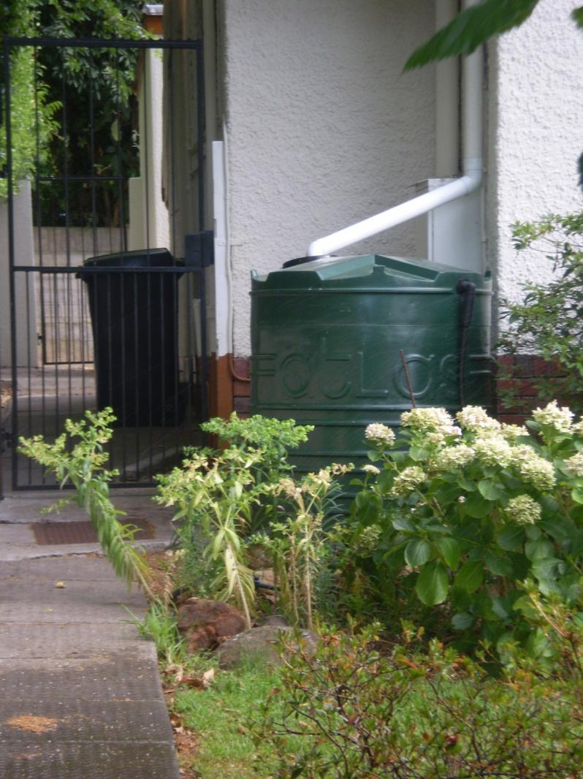
Rainwater and stormwater harvesting
  Rainwater Harvesting – harvesting of water from roofs for water supply (private property owners)
  Stormwater Harvesting – harvesting of water from stormwater systems for water supply (regional scale)
Notes:
Different approach – of course RWH can also be used as a drainage mechanism and Neil will explain this further in his talk about SuDS

Slide 22
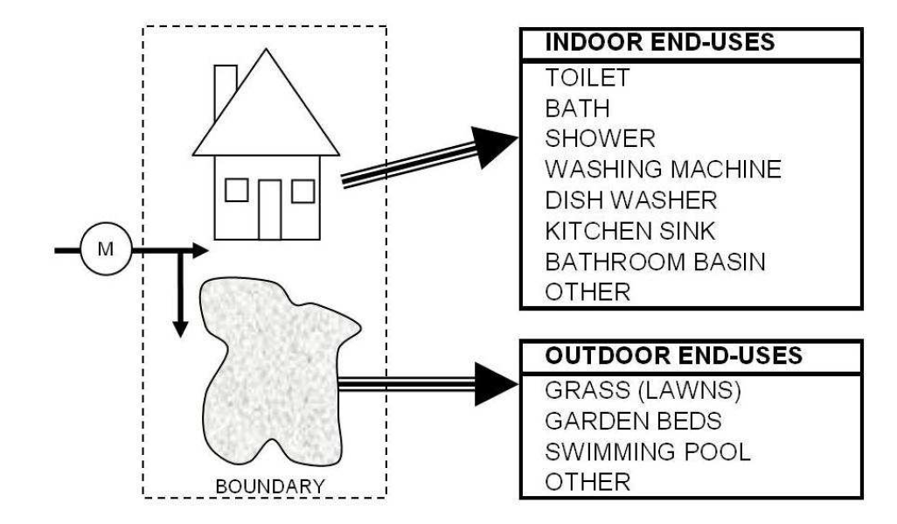
Rainwater use at the household level
Stormwater use
(Jacobs and Haarhoff, 2007)

Slide 23
Positions on SWH
Position 1: SWH improves water security
An alternative source of water
Position 2: SWH reduces flooding
Stores and removes ‘surplus’ SW
Position 3: SWH provides additional benefits
e.g. amenity, ‘value capture’ by adjacent real estate, preservation of biodiversity, reduction of the ‘heat-island’ effect provides ‘sense of place’…

Slide 24
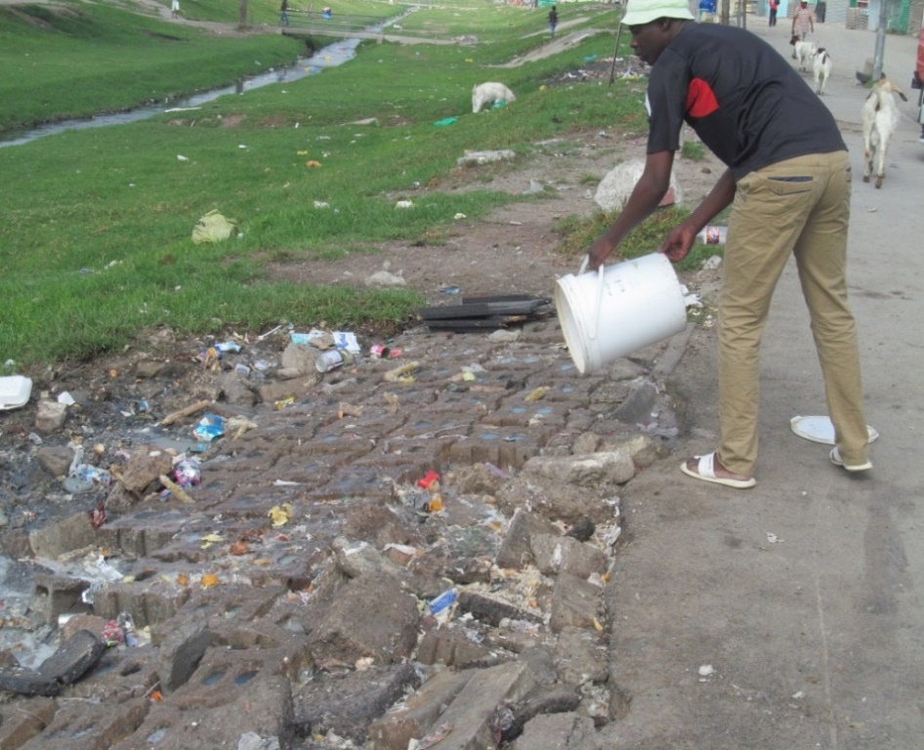
Two big challenges
  Water Quality - SW can be highly contaminated (trash, pathogens, nutrients, heavy metals, sediment etc.)
  Possible solutions: ‘Fitness-for-purpose’ use; treatment – to potable standard if necessary
  Storage - it seldom rains when you want the water!
  Possible solutions: Real-time control of stormwater ponds; Managed Aquifer Recharge
Notes:
AWRMS is an example of a long-term stormwater management system where water is temporarily stored in the unconfined aquifer that underlies the area. The town of Atlantis was planned with MAR in mind, with fully separated residential and industrial areas. This allowed for the separation of high- and low-quality wastewater effluent and stormwater.

Slide 25
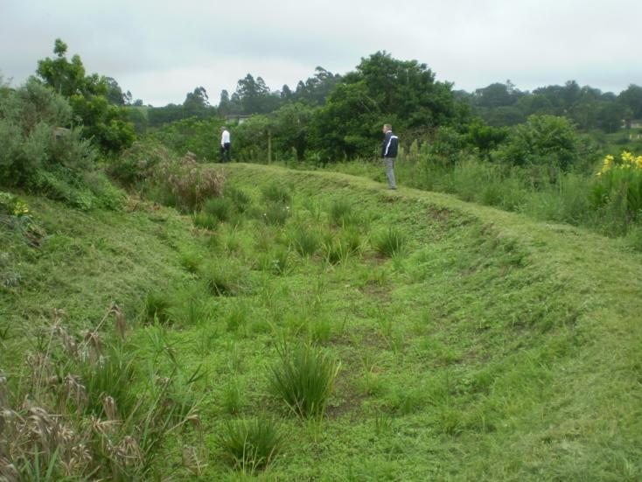
Sustainable Drainage Systems (SuDS)
Mimic the pre-development situation both with regard to runoff quality, runoff quantity, and amenity and biodiversity by:
treating the stormwater as close to its source as possible
using a “treatment train” to successively treat increased post-development pollution and flows
“Soft” engineering – minimise concrete conduits

Slide 26
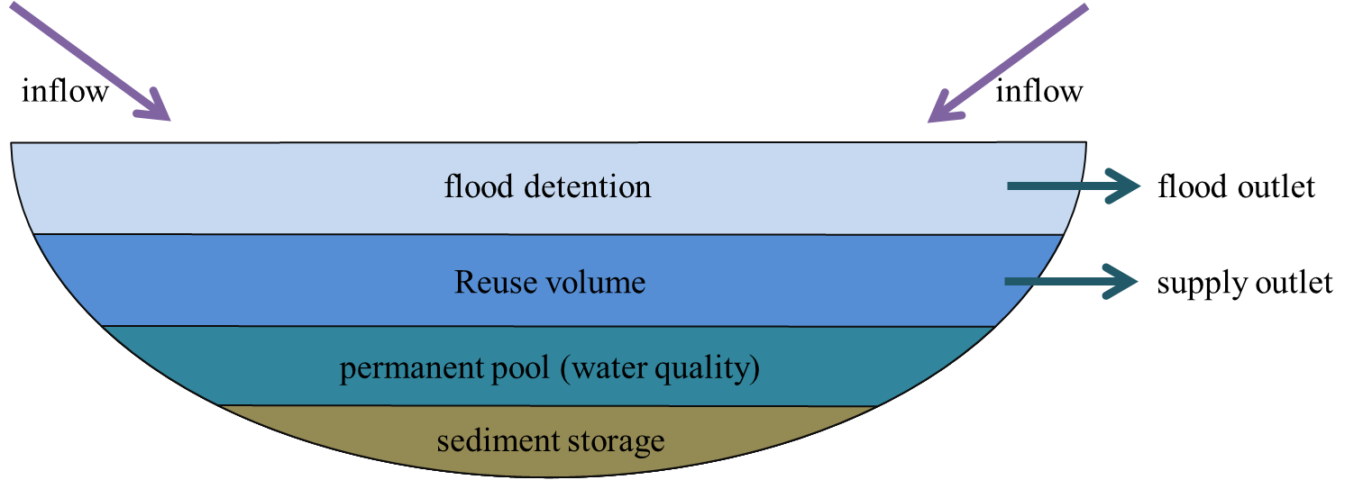
Open storage

Slide 27
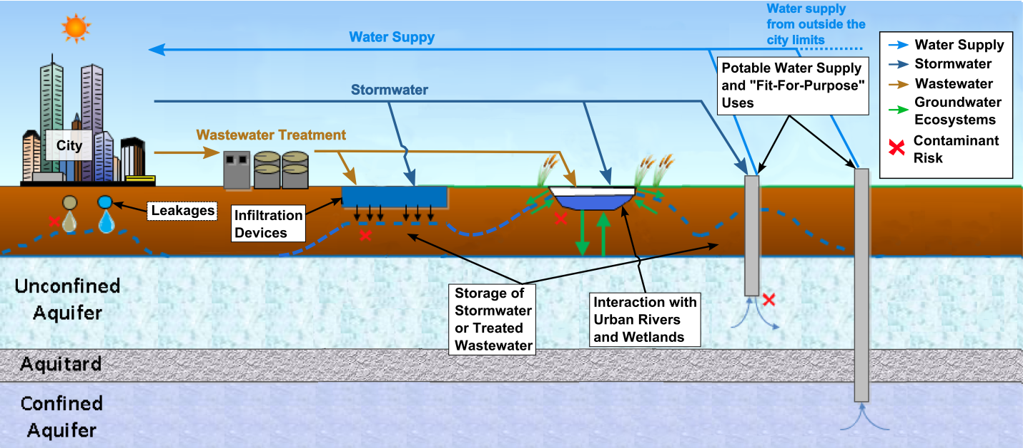
Groundwater storage through MAR

Slide 28
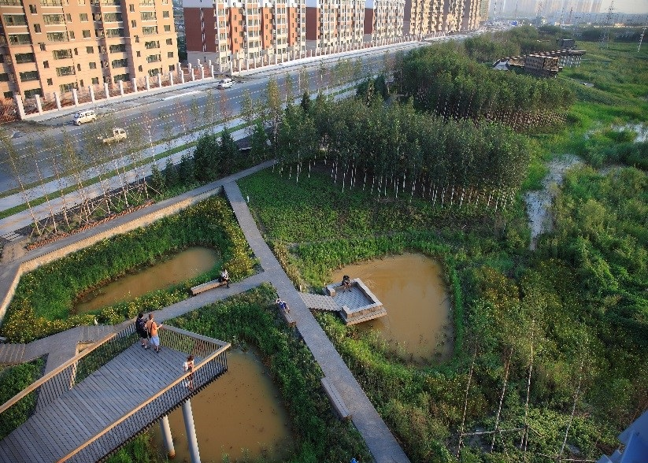
Links to groundwater - Sponge cities
34 ha urban stormwater park in Harbin, China provides multiple ecosystems services
collects, cleanses and stores stormwater, infiltrates to aquifer
protects/recovers natural habitats
aesthetically appealing public space
Requires porous design interventions across the city, and contiguous open green / blue spaces
Notes:
The Sponge City absorbs rain water, which is then naturally filtered by the soil and allowed to reach urban aquifers; allowing for extraction of water from the ground through wells which can be treated and used for city water supply.

Slide 29
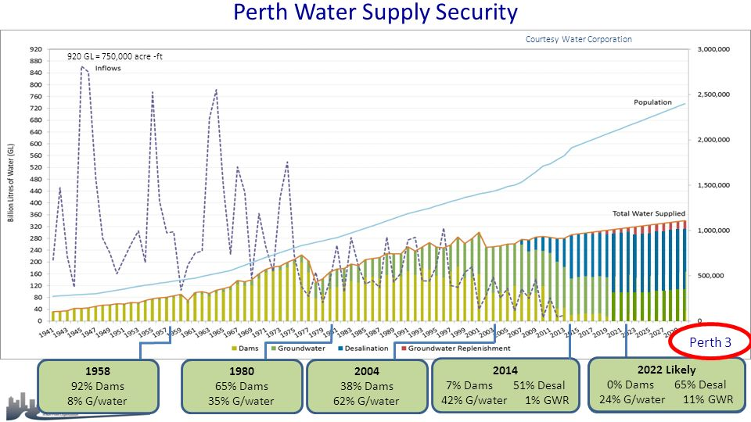
Reshaping water supply - Perth

Slide 30
Pillar 2
Cities providing ecosystem services

Slide 31
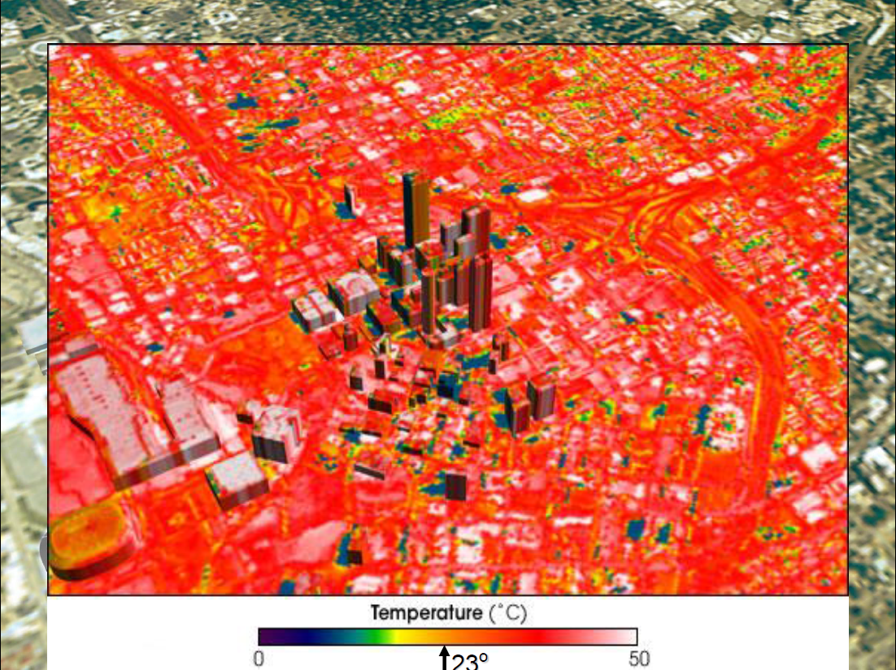

Slide 32
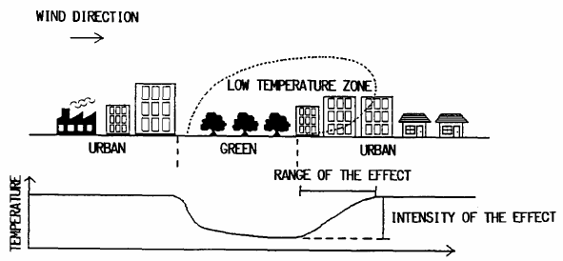
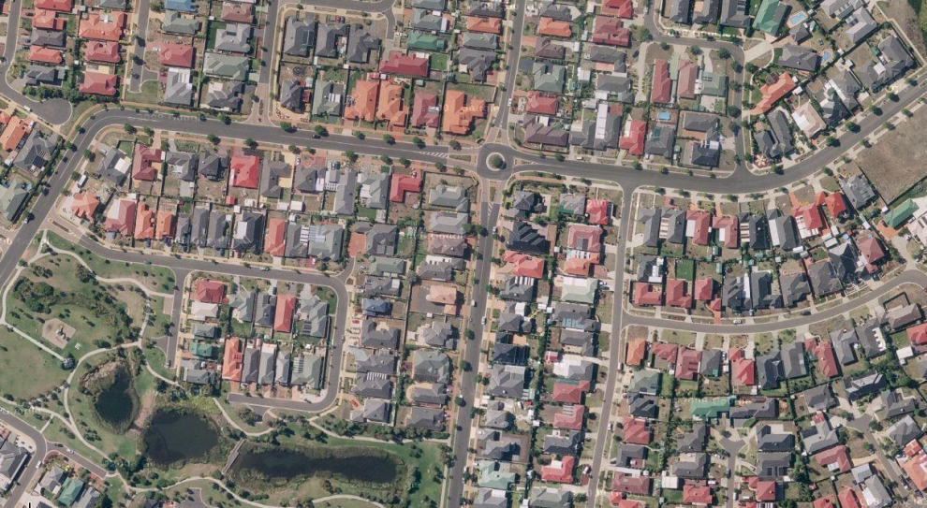
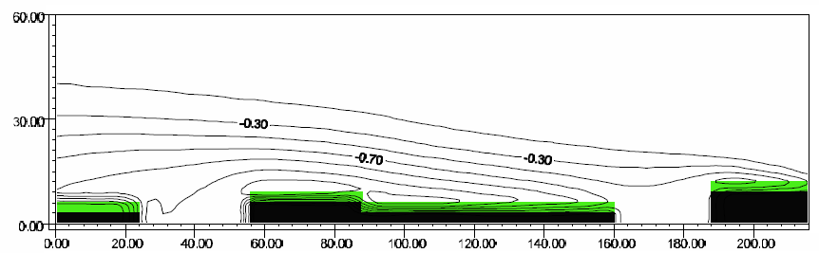
Park ‘cool’ islands
Influence of WSUD features is controlled by its size and location, and local meteorological conditions. As much as 1km downwind…
WSUD needs to be distributed throughout the landscape… and where people actually are!
Stream ecology benefits from distributed systems
Honjo and Takakura, 1990 Energy & Build.
Bruse and Skinner, 1999 15th Int. Cong. Biomet. & Int. Conf. Urban Clim.

Slide 33
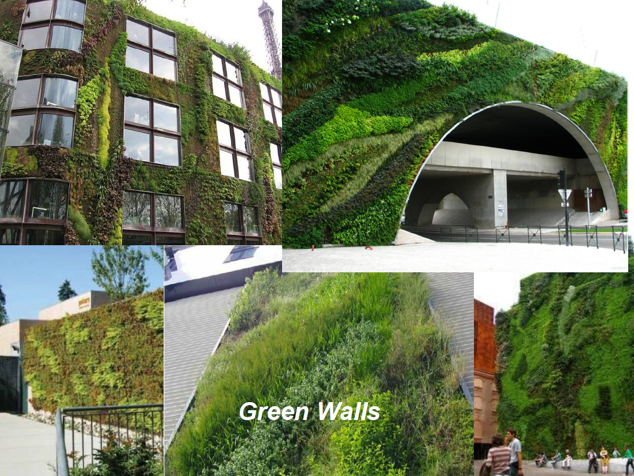

Slide 34
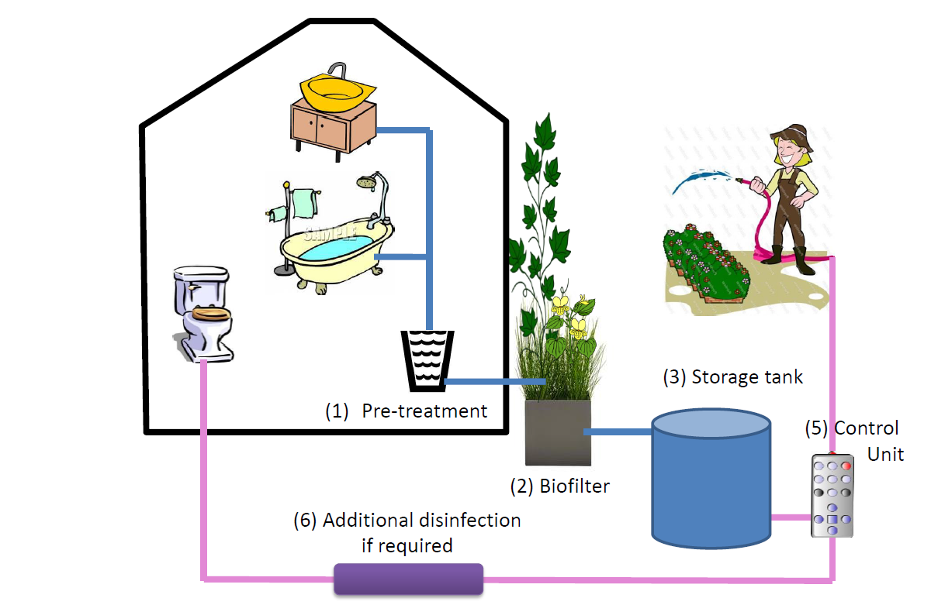
Living wall for greywater recycling

Slide 35
Pillar 3
Cities building capacity and supporting water educated communities

Slide 36
Presenting the benefits of WSUD
Stakeholder | Area of interest
Politicians | Provision of basic services; job creation
City officials | Costs / ease of maintenance
Private developers | Increased profit / public image
Community groups | Job creation; public health / safety
Environmental groups | Protection of environment
Individuals | Additional costs / benefits per household
Notes:
The concept has to be sold to the relevant stakeholders – these are the likely areas of interest for target audiences.

Slide 37
Social – institutional barriers / enablers
Lack of common vision / Champions
Institutional fragmentation / Bridging organisations
Undefined organisational responsibilities / Accountability
Political incentives and/or disincentives / Market receptivity
Poor organisational commitment / Strategic funding
Technological path dependency / Trusted science
Community capacity to participate / Socio-political capital
Lack of experience with facilitating integrated management processes / Binding targets

Slide 38
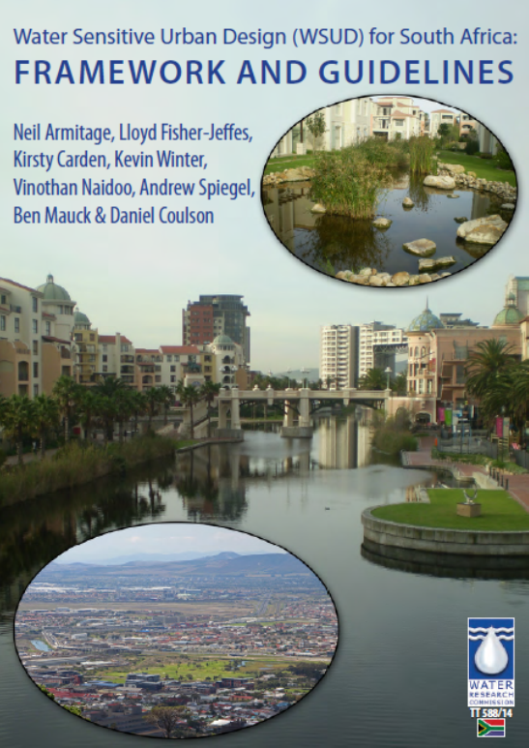
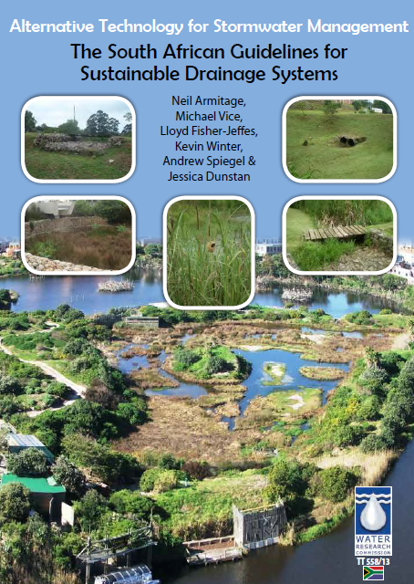
WSUD / SuDS for South Africa

Slide 39
What are the challenges?
Equity
  Dignity; ownership; respect
  Talking of greening cities is ludicrous when basic services do not exist
  Give people basic skills at all levels
Creating systems that can be adapted for the future
  Not maladaptation or technologically locked-into regrettable solutions
Mitigating climate change
  Reducing energy and carbon use
Increasing uncertainty
Population growth, demographics and lifestyles (standards of living)
Enabling legislation
Urban water management and design to be addressed in building regulations, water policy, by-laws etc.

Slide 40
Future water outlook – water sensitivity
Optimise and integrate the management of all available water resources – surface, ground, wastewater and stormwater – to improve resilience
Create liveable urban areas that place high value on water and strive to increase water use efficiency through water sensitive urban design

Slide 41
Thank you
For more information:
www.futurewater.uct.ac.za

Slide 42

Green infrastructure in the Gauteng City Region
https://www.gcro.ac.za/outputs/photo-essays/detail/video-green-infrastructure-in-the-gauteng-city-region/

Slide 43
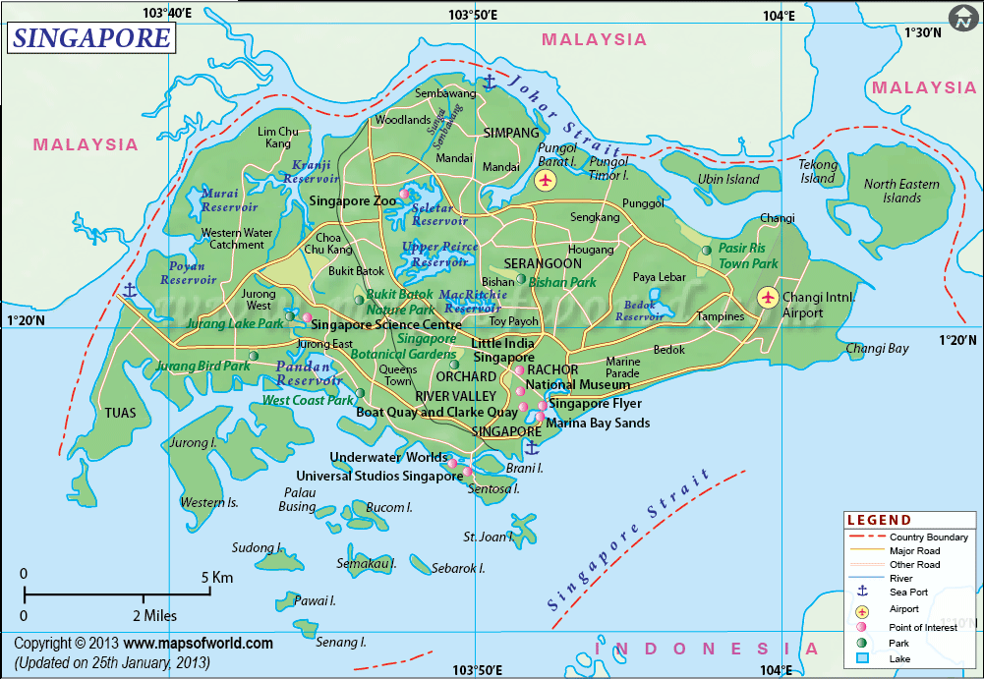
The Singapore story

Slide 44
The four ‘taps’
In a bid to ensure water security, water supply in Singapore is now being diversified. In 2013:
  Imported water from Malaysia (40%)
  Water harvesting from the local catchments (35%)
  Treated effluent (NEWater) (15%)
  Desalinated water from the sea (10%)
The objective is to minimise / eliminate 1. – so as not to be reliant on Malaysia for this critical resource

Slide 45
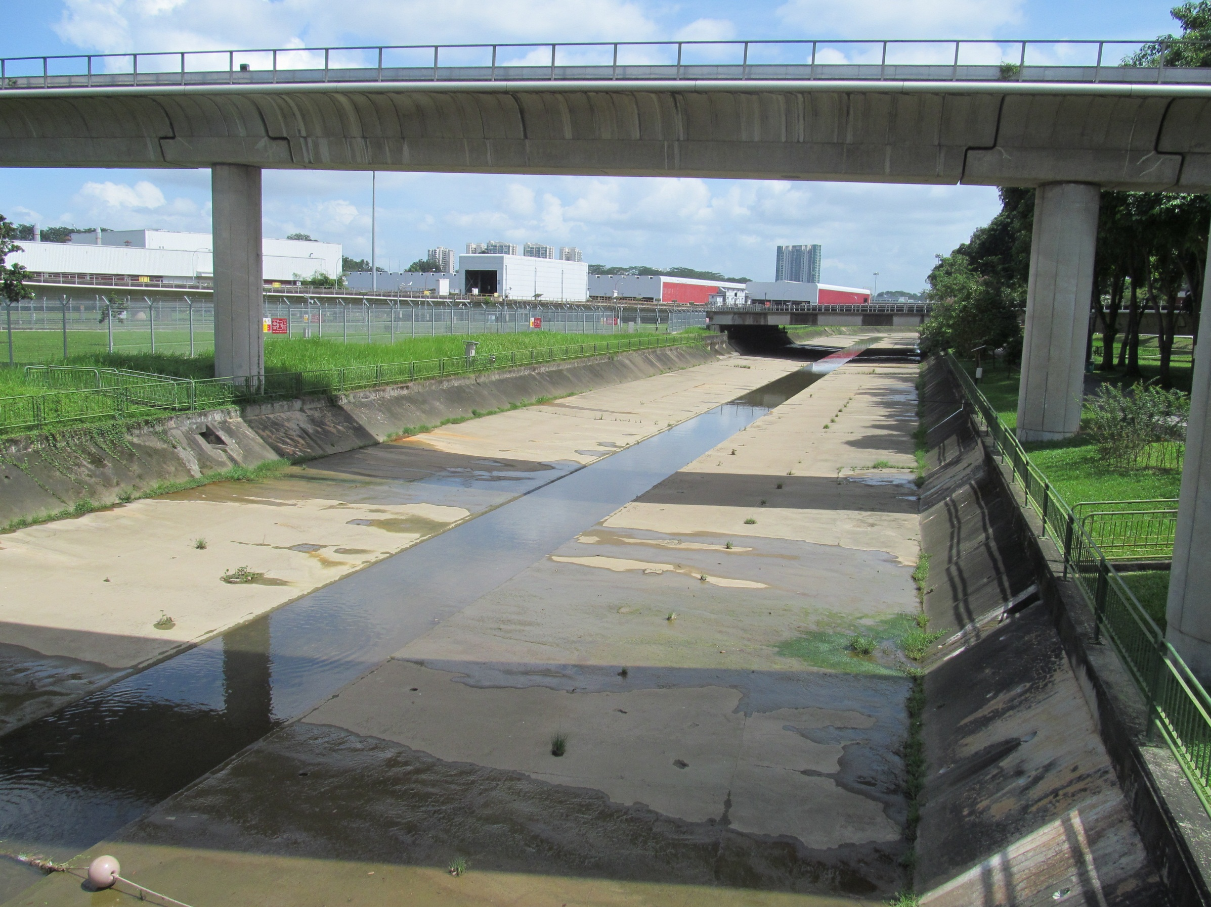

Slide 46
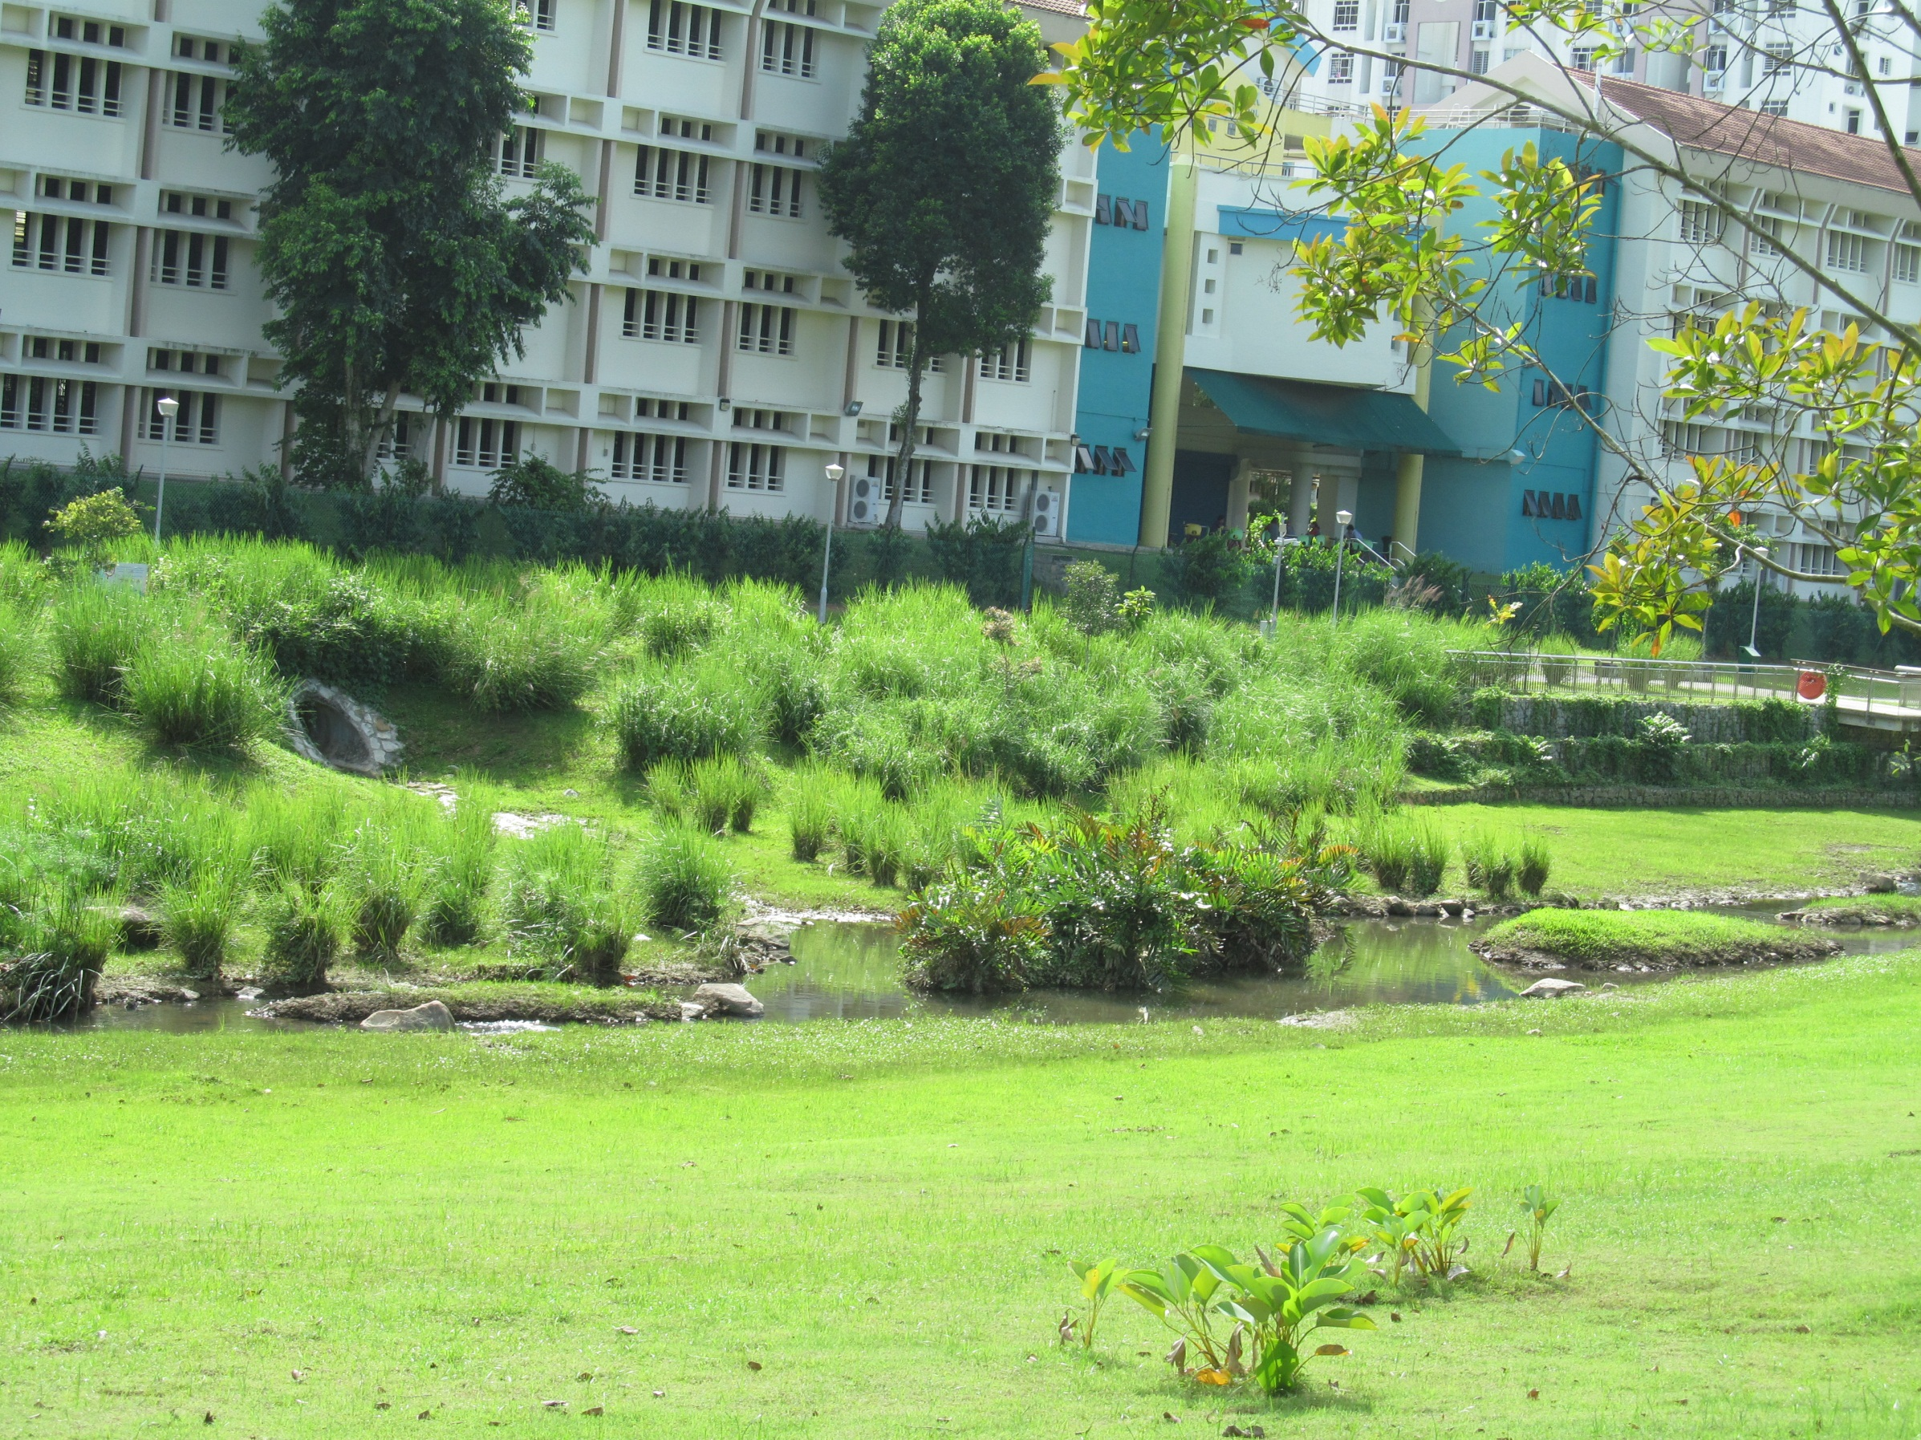

Slide 47
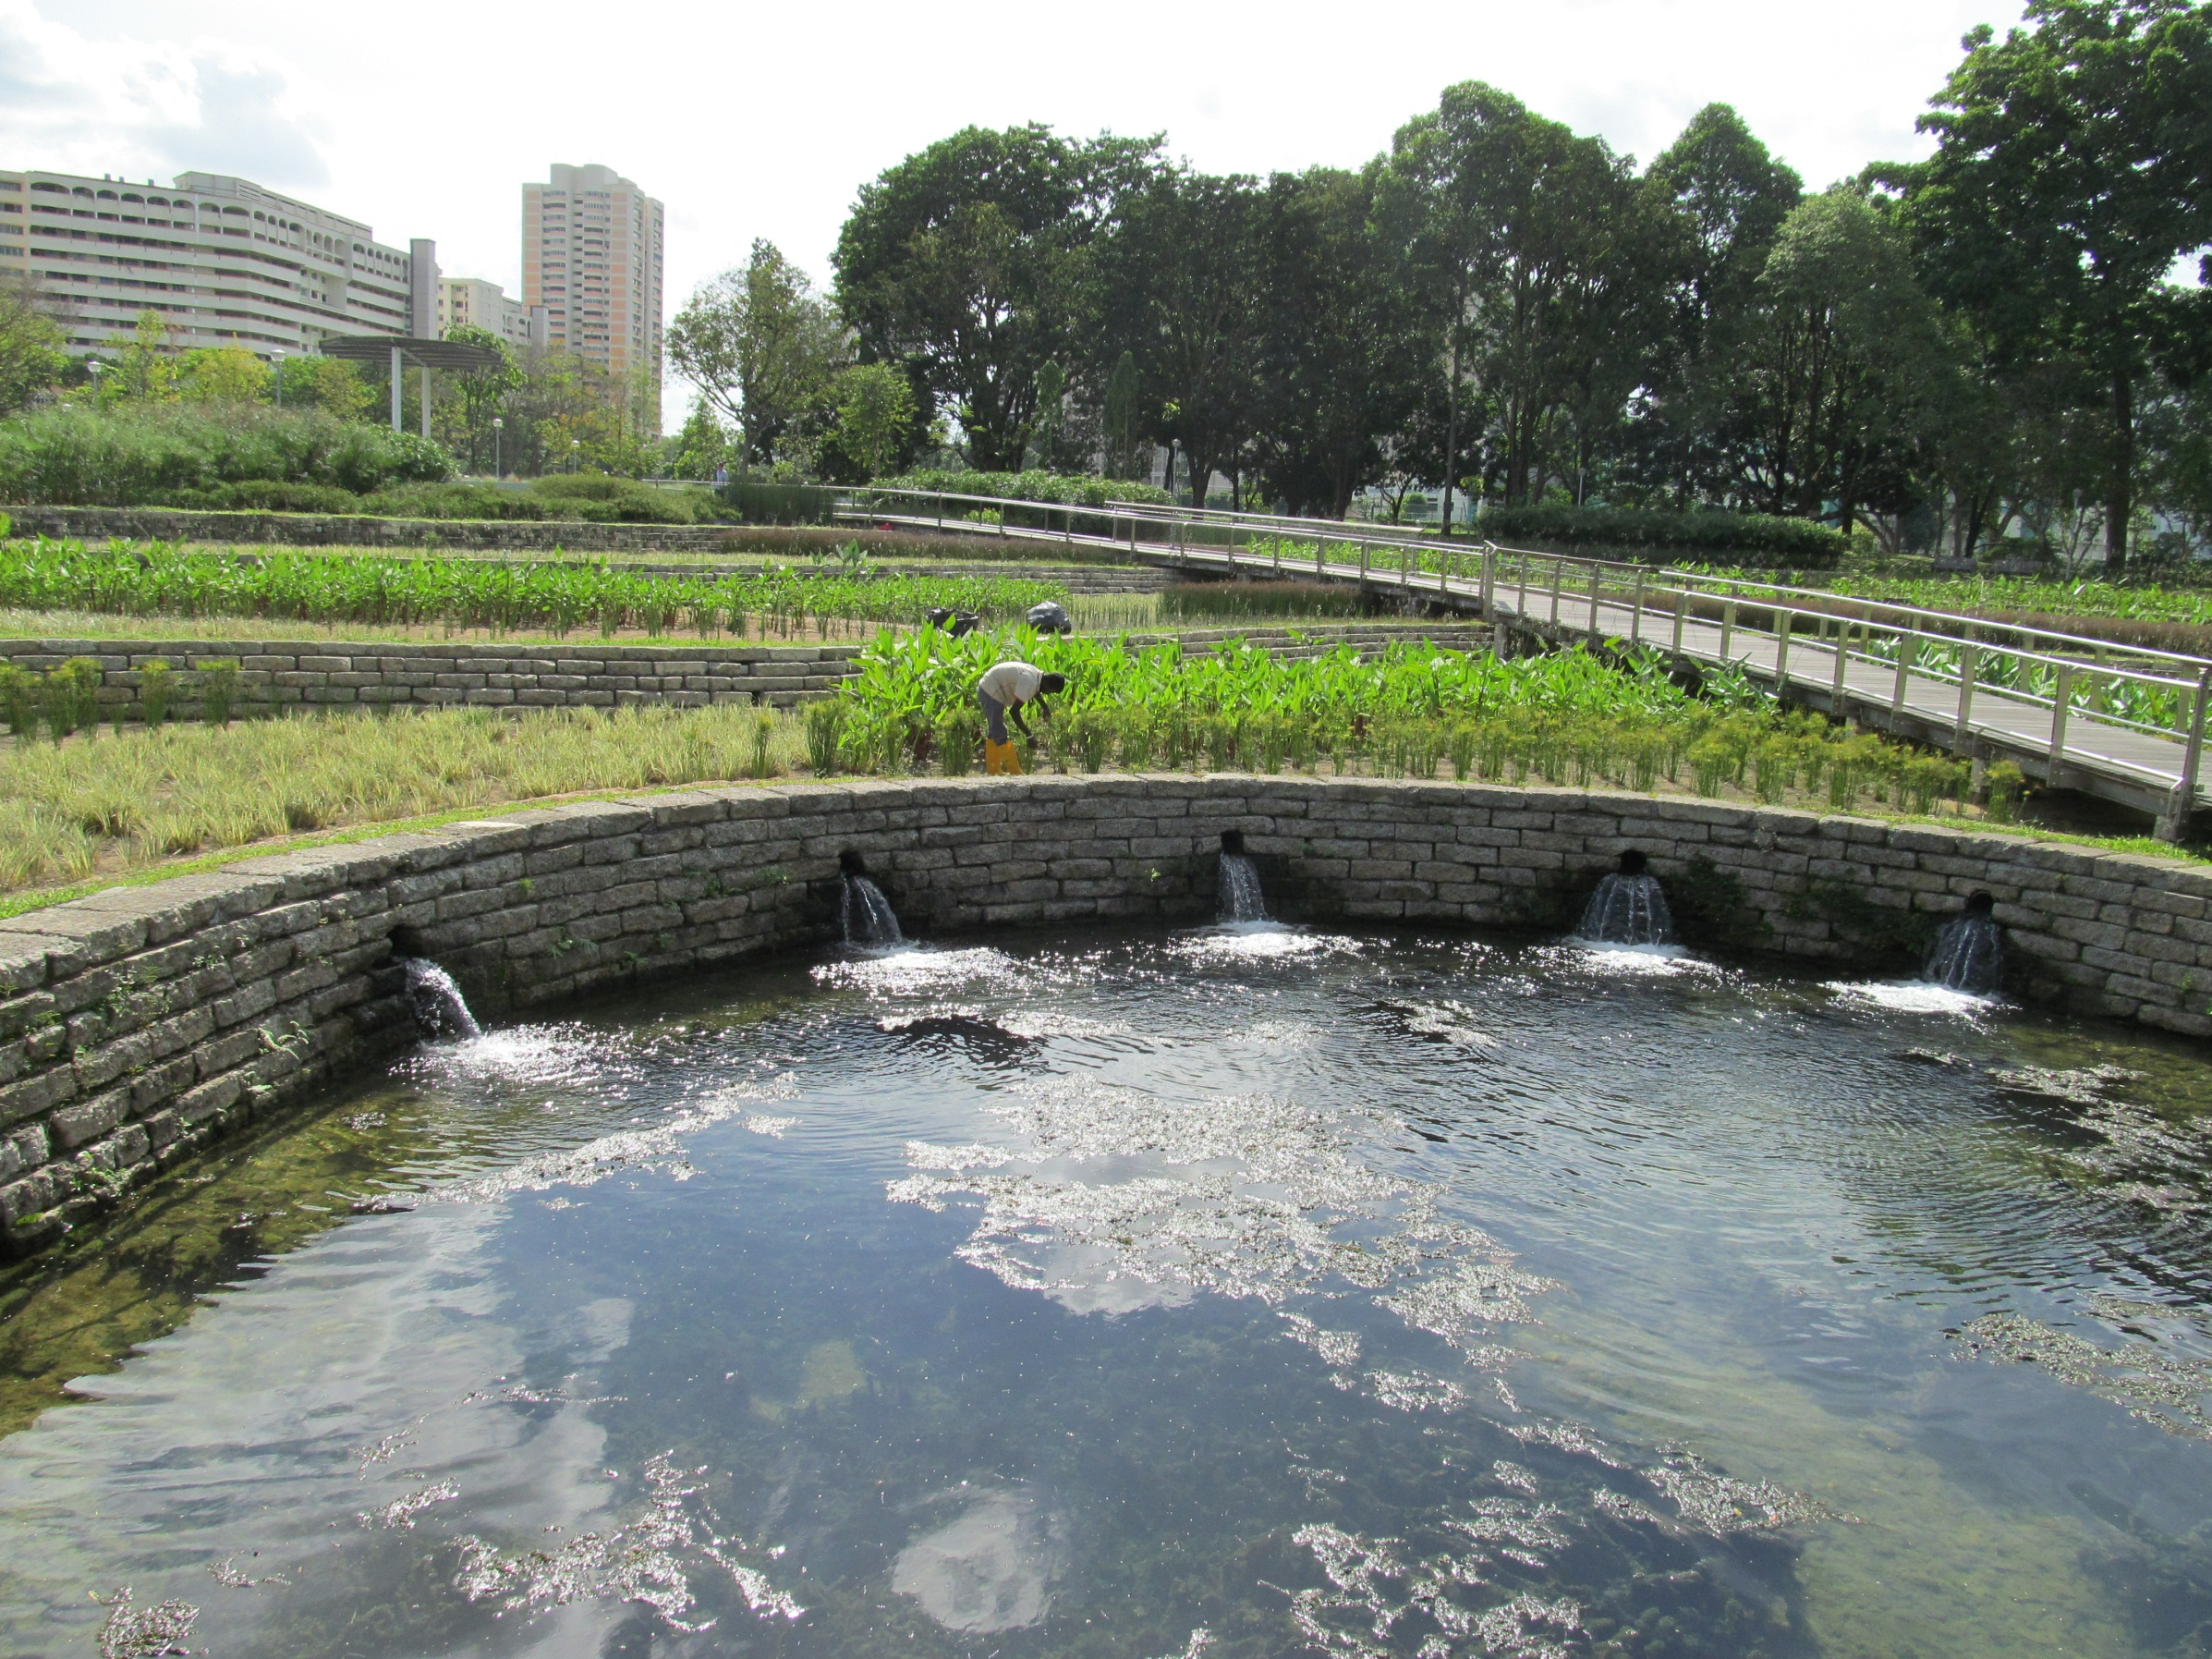

Slide 48
